Slide 1

Introduction to Shiny day 3
Posit Implementation Programme 05/10/2023

Slide 2
Learning Outcomes – Day 3
CSS style script
Publishing a Shiny dashboard
PRA password protection
Making your dashboard more efficient
profvis package

Slide 3
Recap styles
There are several ready made Shiny themes that you can use in your dashboard, see https://shiny.rstudio.com/gallery/shiny-theme-selector.html for full list.
You can use tags, e.g. h1 and tags$i, to change your titles and text
You can use icon() to add any of the icons found on Font Awesome and Glyphicon: https://fontawesome.com/v5.15/icons?d=gallery&p=2 https://getbootstrap.com/docs/3.3/components/#glyphicons

Slide 4
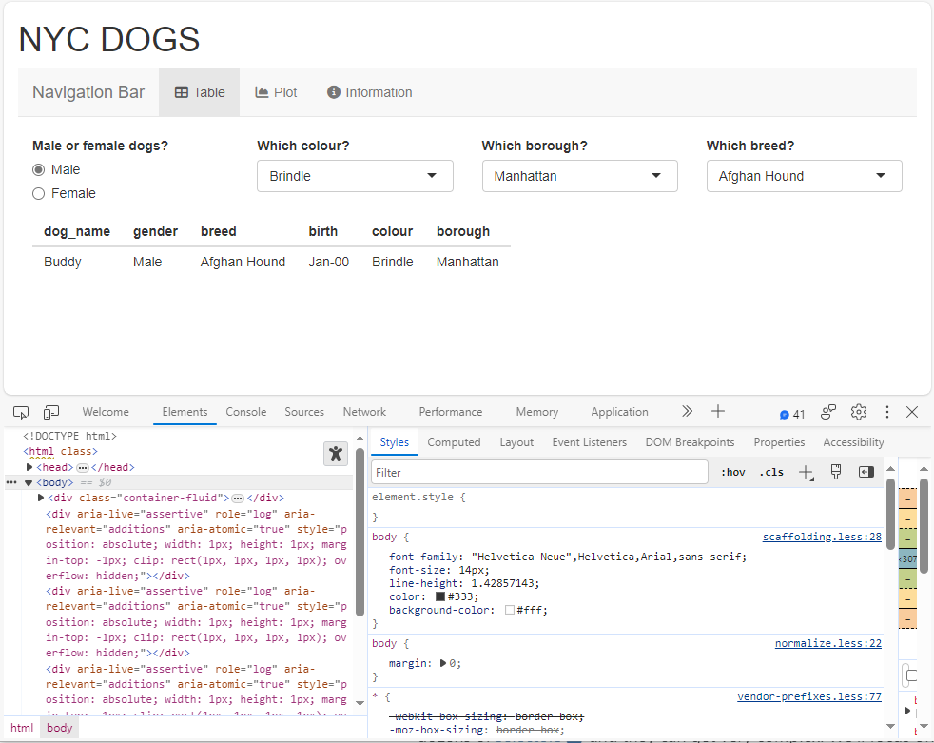
CSS style script
CSS code can be included as part of the UI however, most keep it in a separate script (style.css) that is sourced into the app.
The style script uses CSS code to change the look of the dashboard. Some things you can change are:
Colours of navbar, titlePanel, widgets and drop-downs etc.
Font, colour, size of text and tags
Image and icon sizes and positions
CSS code uses HTML tags followed by a curly bracket and commands within the curly bracket.
NOTE: color in CSS refers to text, and background-color refers to layout

Slide 5
CSS style script
You can change items in the dashboard by finding their HTML tag.
Run app -> Open in Browser -> Right click -> Inspect
“Elements” show the apps html code and “Styles” show the CSS style code for each element
Expand the <body> section of the HTML code in “Elements”.
Hovering over code will highlight the element in the app and clicking on it will show its CSS style code which you can copy into the CSS style script and change in Posit.

Slide 6
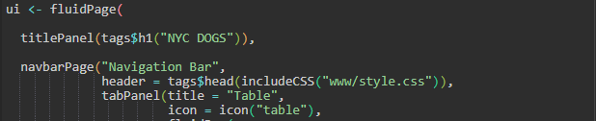
CSS style script Exercise
Create a folder in the same folder as your app from day one, name it “www”.
Copy the style.css script into your new “www” folder.
Add code to UI to source css file.

Slide 7
CSS style script Exercise
“Run app”, open in browser, inspect, and complete the exercises
Open the CSS style script and add code to change the following
Change colour of the h1 tag
Change the navbar title colour, and navbar colour
Change the body colour
Extra: Change the active tab colour
Remember: CSS uses “{}”, “:” instead of “()” for functions and “;” instead of “,” for new functions in the curly brackets.

Slide 8
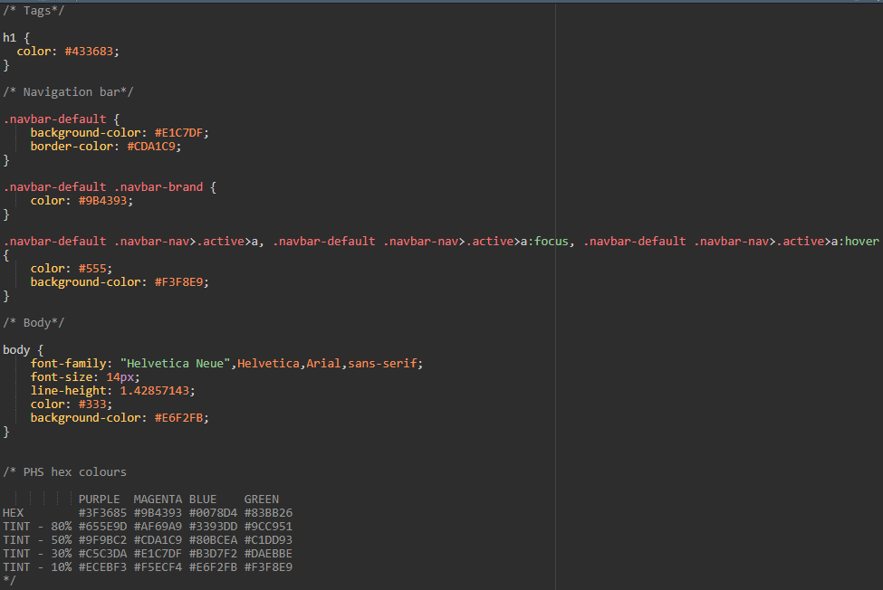
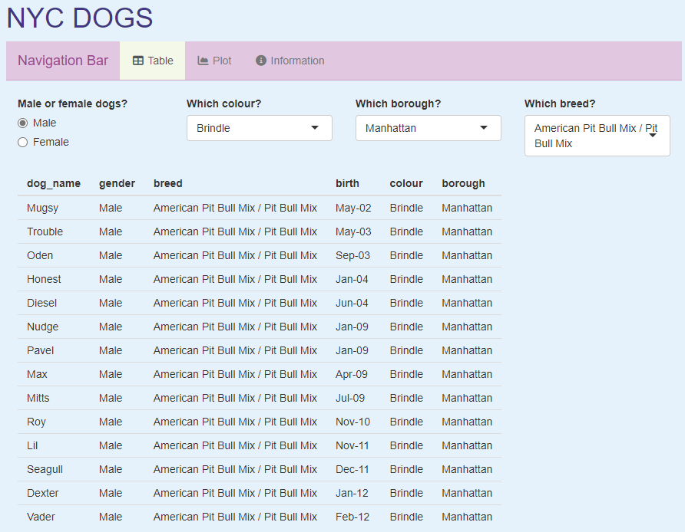
CSS style script Answer

Slide 9
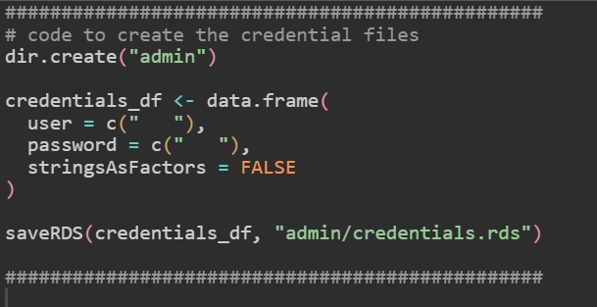
Password Protection
Required when publishing an app for PRA.
We need to create a Create Credentials Script.
This creates an admin folder within our current working directory
This is where we insert our chosen username and password
Reads out a .rds file with our credentials

Slide 10
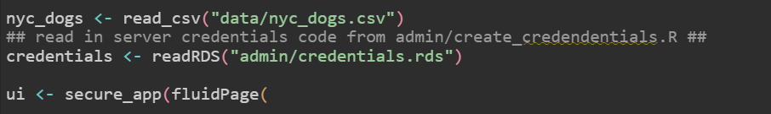
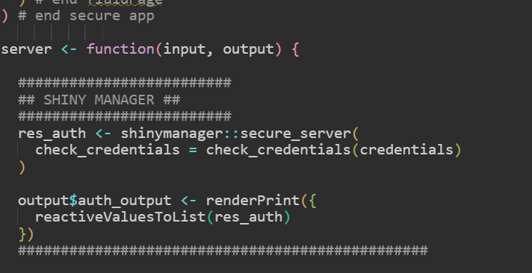
Password Protection: UI and Server
To add password protection to our dashboard we need to wrap our UI within the function shinymanager::secure_app(). Note: We need to install the shiny manager package.
We then need to add the below code into our server.
Reads in our credentials.rds file at start of script and wrap UI in secure_app
Checks what the user enters against the credentials we have set.

Slide 11


Exercise: Password Protection
Create a username and password for your Shiny app.
Wrap the UI within the secure_app function.
Read in your credentials script.
Add the required lines of code to your server.
Run your app – Does your username and password work?

Slide 12
Publishing a Shiny App
For published apps, we use the scotland.shinyapps.io server.
This is shared with the Scottish Government
To deploy an app on this server we need both a Token and a Secret.
These can be obtained from the R Shiny user group by asking who the current administrators are.
Important that you don’t share these codes with others.
The app name should ideally be phs-<nameofapp>-app so that PHS dashboards can be easily identified.
Note: All file paths within the shiny dashboard should be relative and not absolute. I.e. Paths should not be /PHI_conf/… but should be pathways related to the working directory that the Shiny app is in

Slide 13
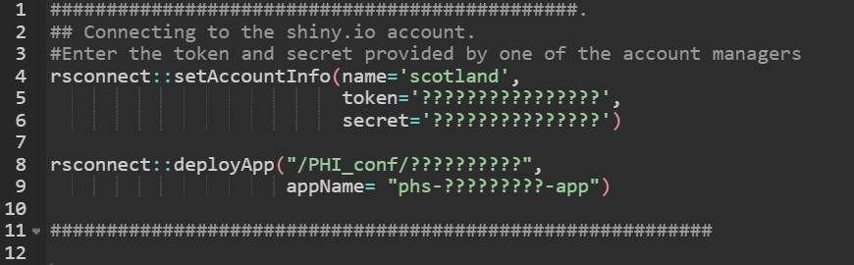
Publishing a Shiny App - Continued
This is the code that we are required to run to deploy our app.
This requires the rsconnect package and the token and secret that we have obtained.
This will publish our app to the web address https://scotland.shinyapps.io/<appName>

Slide 14
Shiny and memory
Each new app is allocated 1GB of memory on the Shiny server and works for most of our apps.
If your app is slow or crashes, before requesting more memory on the server, it is a good idea to profile your Shiny code.
Profiling will show how much memory each function in your script uses
Use profvis() to see how memory intensive your code is. More info here: Profvis — Interactive Visualizations for Profiling R Code (rstudio.github.io)
Running the app in profvis() in the console will, after the app is closed, produce an interactive report of your code.

Slide 15
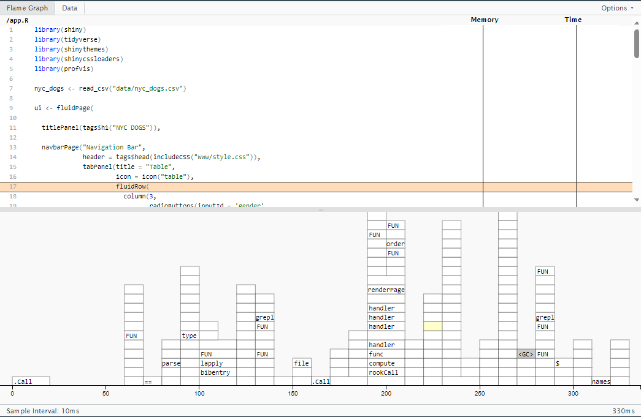
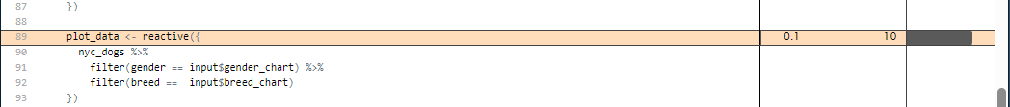
Shiny and memory: profvis profile Flame graph
Shows the full code, and memory and time allocated to each function
Graph shows what other functions are called (call stack) and how long each function run for.
E.g. in our app the most memory intensive function is creating the reactive plot_data

Slide 16
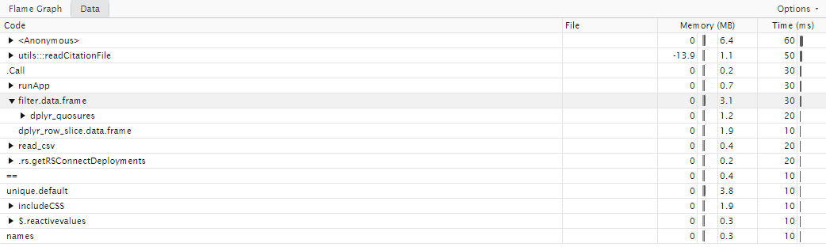
Shiny and memory: profvis profile Data
Shows each function and memory allocation and time for each function.
This is a good place to look when you want to make your app faster and less memory intensive.

Slide 17
Recap Shiny course
You have created a dashboard from scratch with reactive data to user input, a chart, table and information text.
You have created a PHS dashboard displaying Allergic conditions and Asthma data with interactive plots, and data download functionality.
You have learned to change the appearance of your dashboard using CSS.
You have learned to deploy an app and to protect it with a username and password.
You have learned to profile your code to make your app faster.

Slide 18

End of day 3 – any questions?

